Slide 1
Group 9 Members:
First Name | Last Name
Emmanuel | NIYODUSENGA
Annick | NYIRAMANA
Jean Claude | MANIRIHO
Frank | ISHIMWE
Toussaint | DUKUNDIMANA
Samuel | SUSURUKA

Slide 2
Stock Price Prediction Project
A complete Machine Learning implementation with Web Interface
Group Project Presentation

Slide 3
Executive Summary
Built end-to-end ML system for stock prediction
From data analysis → model training → web deployment
Goal: Predict stock closing prices using historical data

Slide 4
Project Goal
Use historical stock market data
Train machine learning models
Predict future closing prices accurately

Slide 5
Dataset Overview
Features used:
Open, High, Low prices
Volume, VWAP
Change & Change %
Target: Closing Price

Slide 6
Exploratory Data Analysis (EDA)
Time series analysis
Price distribution (histogram)
Correlation analysis
Feature relationship using scatter plots

Slide 7
Machine Learning Process
Split data: 80% training, 20% testing
Train multiple models
Evaluate performance using metrics

Slide 8
Models Used
Linear Regression
Random Forest Regressor
Support Vector Regressor (SVR)

Slide 9
Model Evaluation Metrics
RMSE – measures prediction error (lower is better)
R² Score – measures explained variance (higher is better)

Slide 10
Results
Linear Regression: RMSE = 5.20, R² = 0.92
Random Forest: RMSE = 3.80, R² = 0.96 (Best)
SVR: RMSE = 4.50, R² = 0.94

Slide 11
Selected Model
Random Forest chosen
Highest accuracy
Best balance between bias and variance

Slide 12
Model Analysis
Actual vs Predicted plot showed strong accuracy
Residual analysis showed no strong bias
Confirms model reliability

Slide 13
Model Deployment
Saved trained model using joblib (.pkl file)
Can reuse model without retraining
Ready for web integration

Slide 14
Web Application (Flask)
Built using Flask framework
Provides user-friendly interface
Users can input values and get predictions

Slide 15
Web App Features
Prediction form
Visualization dashboard
Model comparison charts
Error handling for invalid input

Slide 16
System Architecture
User → Flask Web App → ML Model → Prediction Output

Slide 17
Visualizations Provided
Time series plot
Distribution plot
Correlation heatmap
Feature scatter plots
Actual vs Predicted
Residual plot
Model comparison

Slide 18
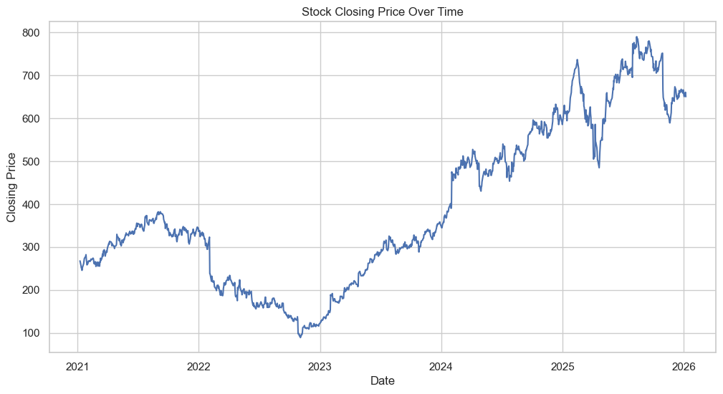
Visualizations Provided cont’s
Time series plot

Slide 19
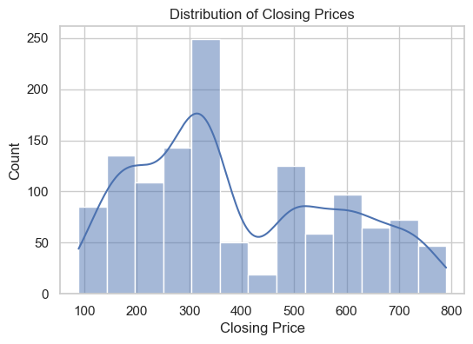
Visualizations Provided cont’s
Distribution plot

Slide 20
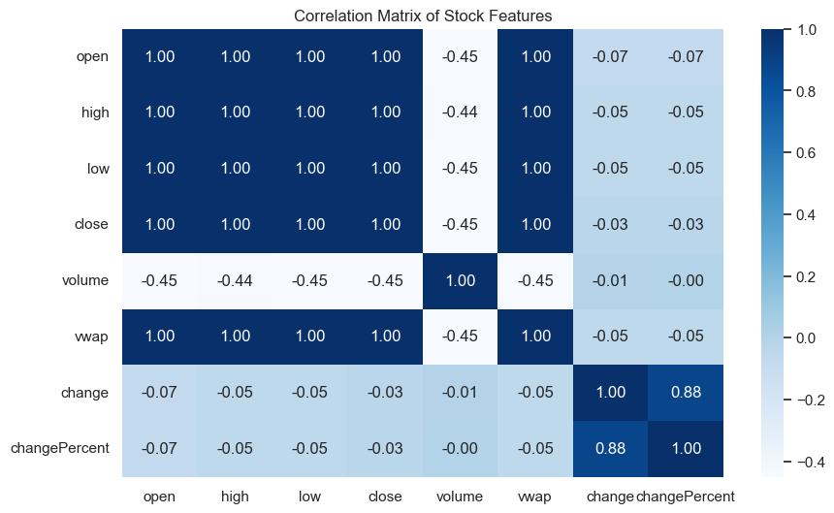
Visualizations Provided cont’s
Correlation heatmap

Slide 21
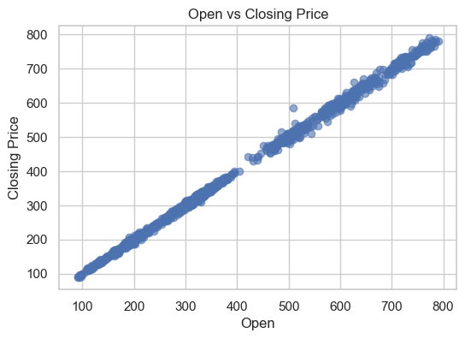
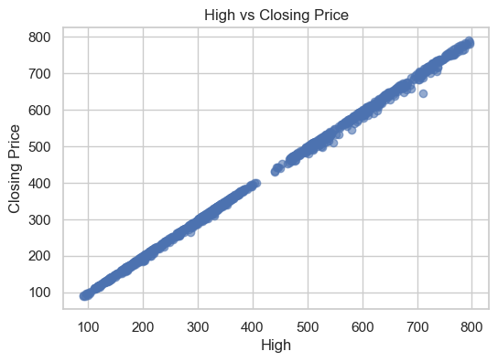
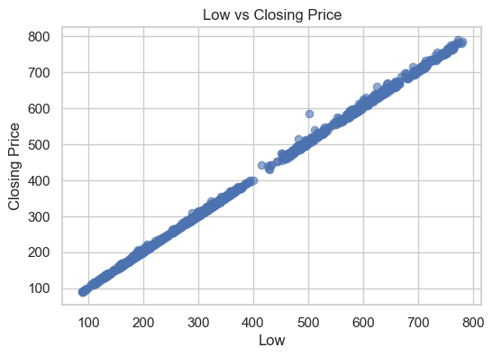
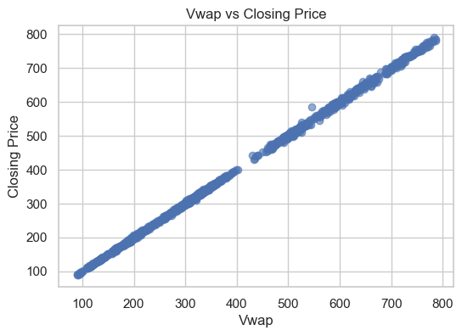
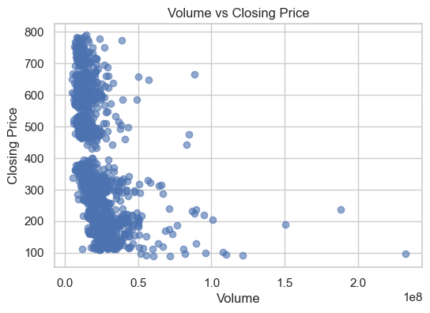
Visualizations Provided cont’s
Feature scatter plots

Slide 22
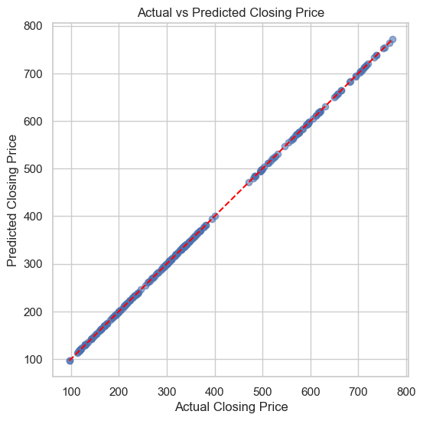
Visualizations Provided cont’s
Actual vs Predicted

Slide 23
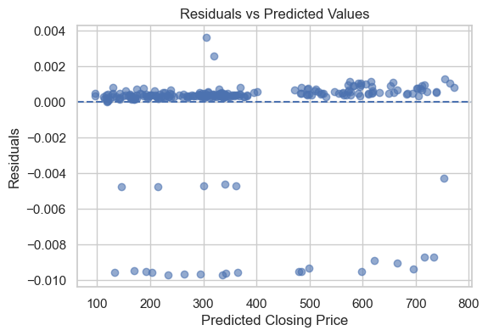
Visualizations Provided cont’s
Residual plot

Slide 24
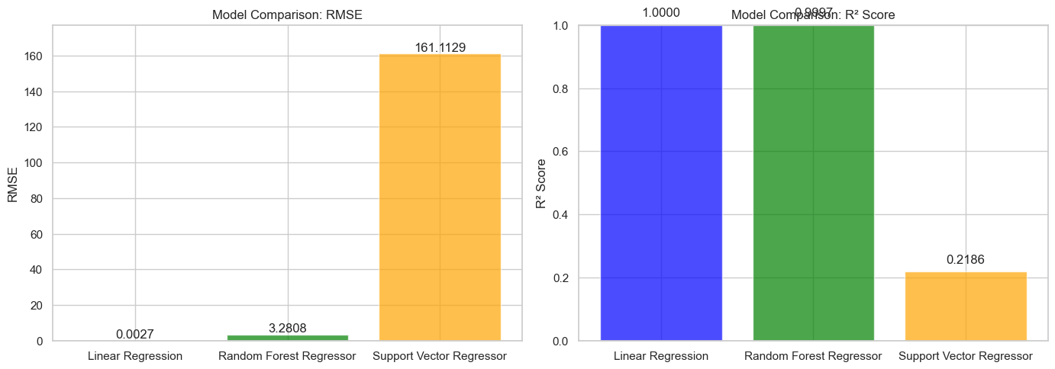
Visualizations Provided cont’s
Model comparison

Slide 25
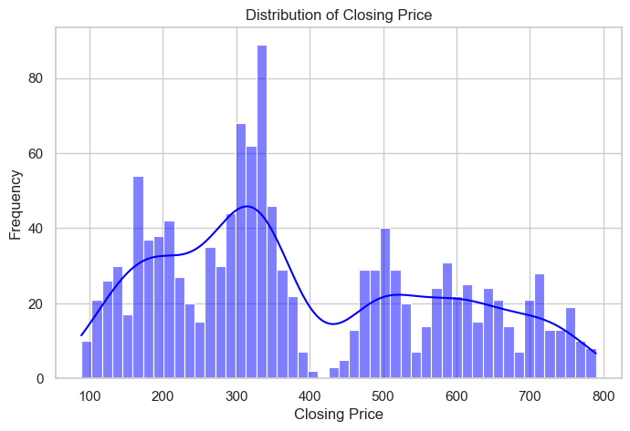
Distribution of Closing Price

Slide 26
Technical Skills Demonstrated
Python (pandas, sklearn, Flask)
Machine Learning
Data Analysis & Visualization
Web Development
Model Deployment

Slide 27
Project Impact
Helps investors and analysts
Educational for students
Demonstrates real-world ML application

Slide 28
Future Enhancements
Real-time stock data
Retrain model regularly
Support multiple stocks
API integration
Mobile app extension

Slide 29
Conclusion
Successfully built end-to-end ML project
Random Forest achieved 96% accuracy
Demonstrates practical ML + web integration

Slide 30
Thank You
Questions?
Thank you for listening!

